Slide 1
Duplicate Address Prediction
19 Aug 2025 – Aman Sharma

Slide 2
Objective
The code aims to detect and resolve duplicate provider addresses using a multi-step approach:
1. LLM-Based Address Pairing:
- Uses Snowflake Llama to identify potential address matches.
2. Graph-Based Grouping:
- Applies disjoint set union (DSU) to group related addresses.
3. Winning Address Determination:
- Applies business rules to select the most appropriate address.

Slide 3
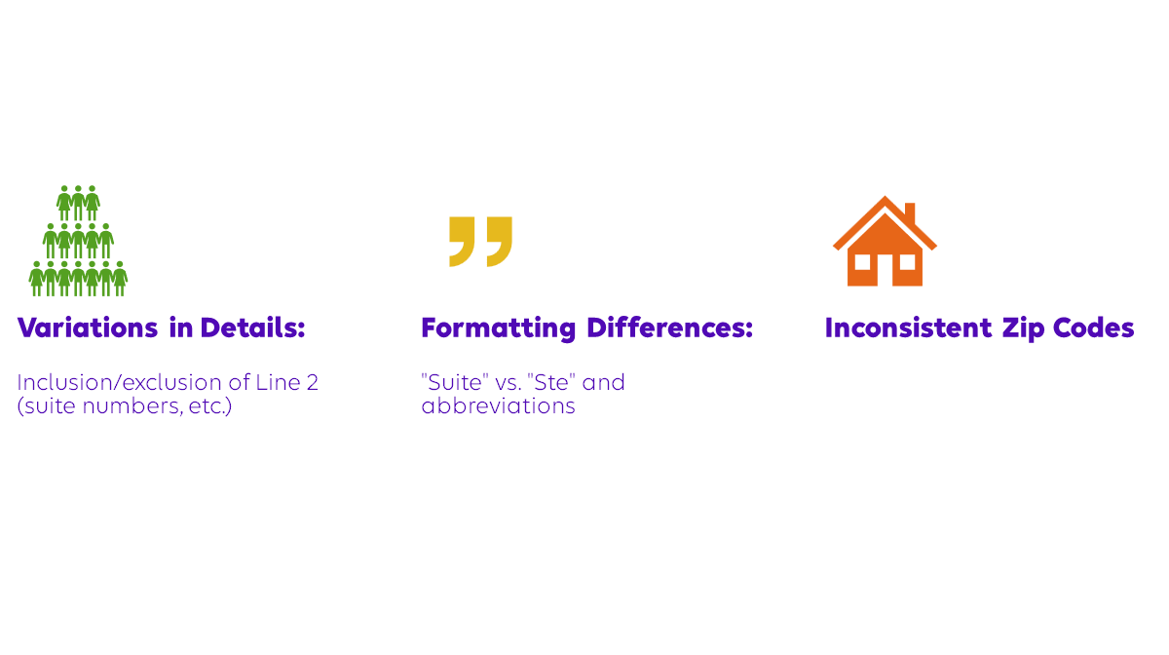
Causes of Address Discrepancies

Slide 4
Data Sources
Tables Utilized:
POA_NTWK, STNDRDZD_ADRS, CLM_WGS_GNCNATP_EA1_CMPCT - Network and address standardization.
POA, PROV, CD_VAL - Provider information and classification.
RLTD_PADRS_NTWK, RLTD_PADRS, PROV_ORG_NTWK - Related provider addresses and organizational networks.
NTWK, GRPG_POA_NTWK, GRPG_RLTD_PADRS_NTWK - Network details.
RMTNC, POA_RMTNC, POA_NTWK_ALT_IDFCTN - Payment remittance and alternate identification.
IND_ZIP_CD, POA_ALT_IDFCTN, RLTD_PADRS_NW_ALT_IDFCTN - Geographical and alternate ID information.

Slide 5
LLM-based Address Pairing and Validation
Functionality: Using snowflake-llama-3.1-405b, the LLM models' language patterns to identify potential matching addresses by interpreting variances in natural linguistic structure.
Function: create_paired_dataframe_step1: Extracts and pairs address components considering linguistic nuances through regex and heuristic approaches.
Function: process_llm_comparisons: Evaluates potential address matches, assigning flags to guide further review and filter true positives.
Outcome: Provides a curated set of address pairings based on language model predictions, forming the foundation for deeper analysis.

Slide 6
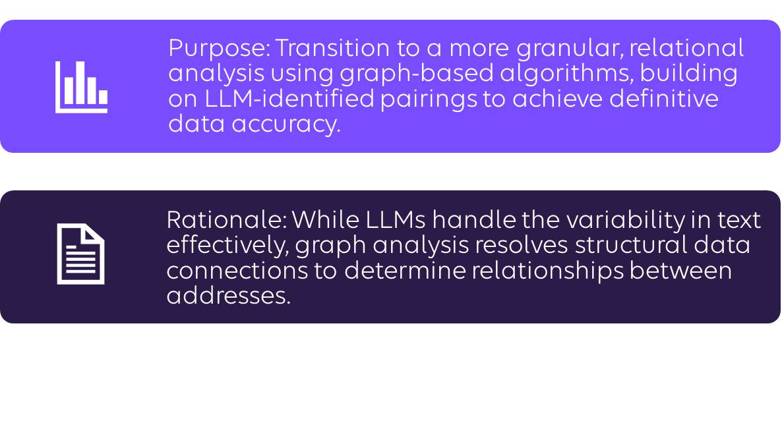
Transition from LLM to Graph Approach

Slide 7

Graph-based Grouping and Analysis
Notes:
1.The different combination of input features that are used for modelling.
2. The pattern for the IHAN models with digits in their name is like so The first digit in the IHAN model name represents the number of codes used as input features, The second digit represents whether the lab pair (revenue code) is used or not: 0 indicates the lab pair is not used. The third digit represents whether the static features, namely age etc.

Slide 8
Sample Data
MSTR_PROV_ID | POA_KEY_1 | POA_KEY_2 | IS_ADDRESS_SAME
1001 | 5001 | 5002 | TRUE
1001 | 5003 | 5004 | FALSE
1002 | 5005 | 5006 | TRUE
1002 | 5007 | 5008 | TRUE
MSTR_PROV_ID | poa_keys_1 | poa_keys_2 | edges
1001 | [5001, 5003] | [5002, 5004] | [{5001, 5002}]
1002 | [5005, 5007] | [5006, 5008] | [{5005, 5006}, {5007, 5008}]
MSTR_PROV_ID | poa_keys | edges
1001 | [5001, 5002, 5003, 5004] | [{5001, 5002}]
1002 | [5005, 5006, 5007, 5008] | [{5005, 5006}, {5007, 5008}]
Notes:
past 24 months countback from the delivery date – input features ?

Slide 9
Final Output after group Assignment
MSTR_PROV_ID | POA_KEY | GROUP_ID
1001 | 5001 | 1
1001 | 5002 | 1
1001 | 5003 | 2
1001 | 5004 | 3
1002 | 5005 | 1
1002 | 5006 | 1
1002 | 5007 | 2
1002 | 5008 | 2
Notes:
The braces features indicates what are the static features are used for the modelling.

Slide 10
Winning Address Determination
Criteria and Evaluation:
Function: postprocess_group: Enforces business rules to assign status and action on identified address groupings
Outcome: Clears ambiguities, determining "winning" addresses among duplicates, and applies standardized responses.

Slide 11
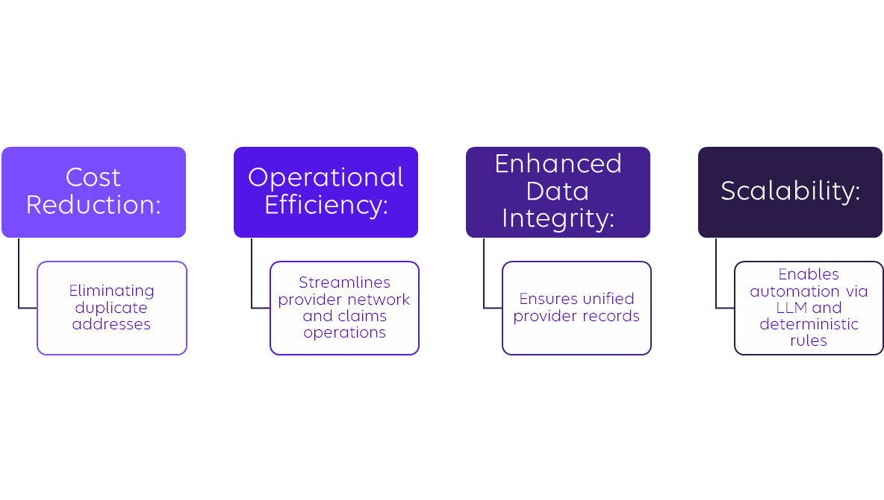
Business Value

Slide 12
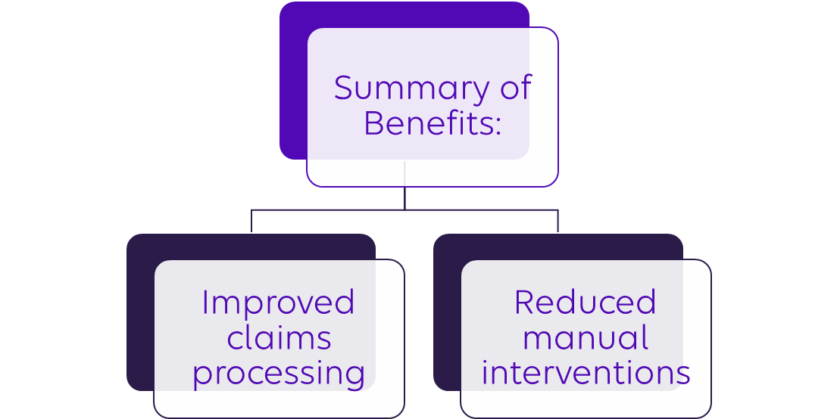
Conclusion

Slide 13
Thank you!

